Slide 1

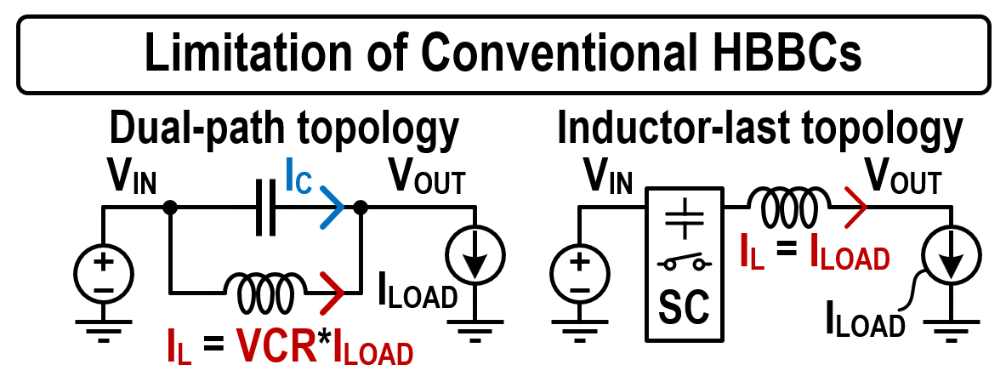
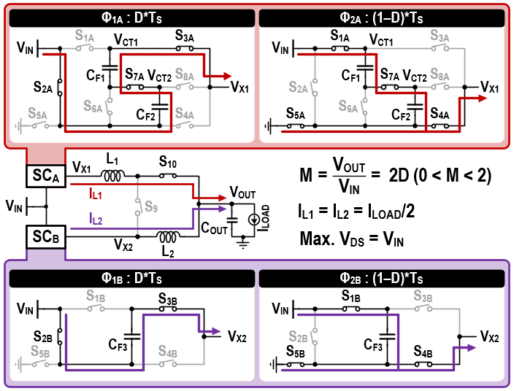
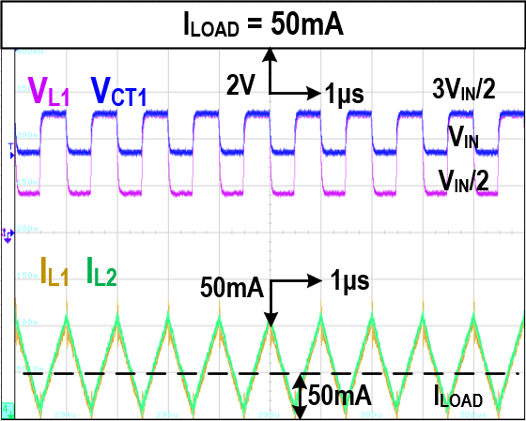
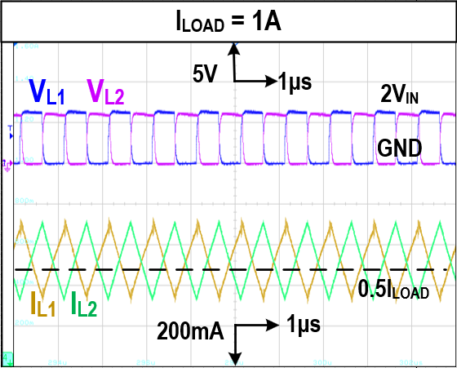
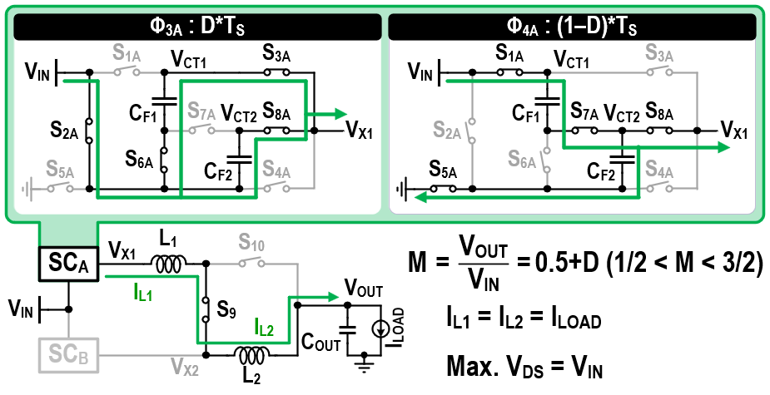
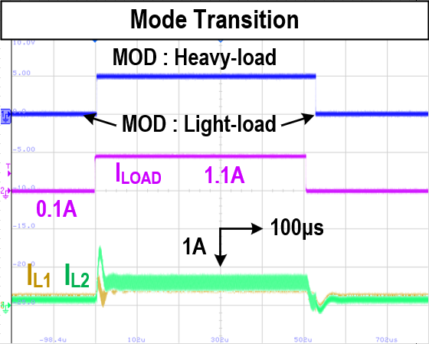
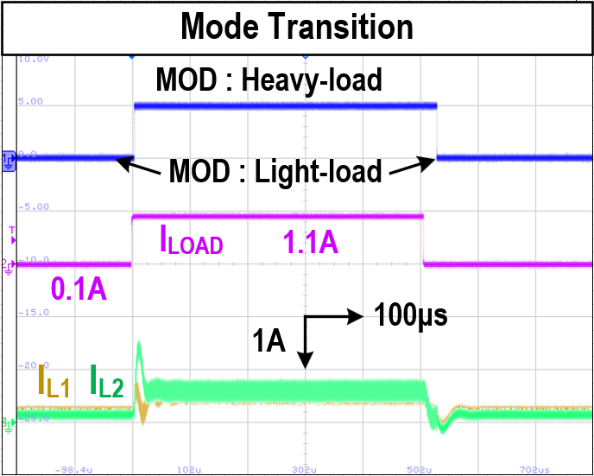
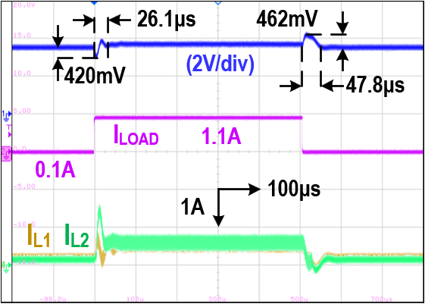
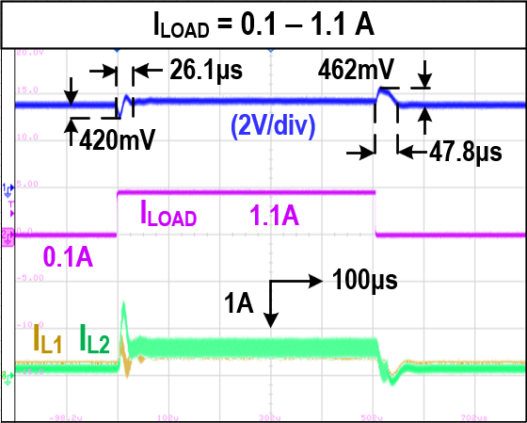
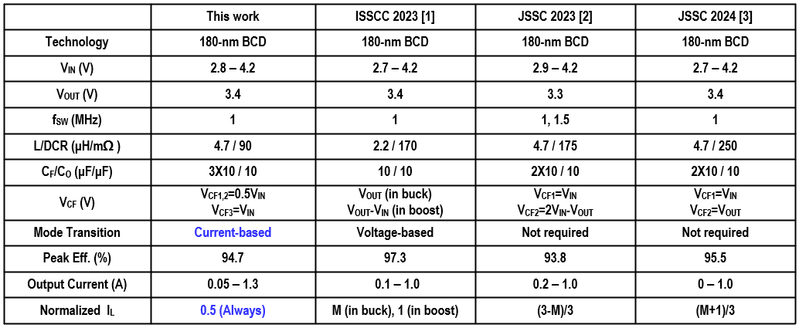
A Current-Based Reconfigurable Hybrid Buck–Boost Converter
with Load-Dependent Mode Switching and Single-Duty Control
Jonghun Chae, Sungjun Moon, and Inho Park
Department of Electrical and Computer Engineering, Inha University, Korea
Introduction
Hybrid buck–boost converter (HBBC) is required in mobile systems
Multi-mode HBBCs: mode mismatch, large V_{OUT} ripple ☹
Dual-path topology: I_{L} reduced ☺ but VCR-dependent ☹
Inductor-last topology: I_{L} = I_{LOAD} ➔ limited PCE ☹
Proposed CR-HBBC: current-based control ➔ VCR-independent I_{L} optimization ☺
Proposed Converter Operation in Heavy Load Condition
Proposed Mode Selector Operation
Adaptive mode-transition logic determines MOD based on V_{PK} and V_{AVG} comparison.
Ensures seamless transition between light and heavy load modes.
Measurement Results in V_{IN} = 3.4V, V_{OUT} = 3.4V
At heavy load, both inductor currents are delivered to the load simultaneously, reducing DCR conduction loss by 50%.
Proposed Converter Operation in Light Load Condition
At light load, series-connected inductors double the effective inductance, reducing current ripple and enabling CCM operation.
Comparison Table
Chip Photo and Power Conversion Efficiency
[1] J. Jin et al., ISSCC Dig. Tech. Papers, Feb. 2023
[2] D. Cho et al., IEEE JSSC, 2023.
[3] D.-H. Kim et al., IEEE JSSC, 2024.
The chip fabrication and EDA tool were supported by the IC Design Education Center (IDEC), South Korea.
This work was supported by the National Research Foundation of Korea (NRF) grant funded by the Korea government
(MSIT) (RS-2026-25497457).

